Slide 1

SMILE FARM Project Synopsis Presentation Date: 28/09/2017
Industrial Project(Synopsis & Presentation)(ECS799)
B.Tech (CSE)
Internal Project Guides:
Mr. Mahendra Singh Sagar
Ms. Deepti Agrawal
External Project Guide:
Mr. Amit Kumar Roy
Group: SMILE-FARM DEVELOPERS
Paras Rastogi(TCA1409048)
Swapnil Jain(TCA1409072)
COLLEGE OF COMPUTING SCIENCES AND INFORMATION TECHNOLOGY
TEERTHANKER MAHAVEER UNIVERSITY, MORADABAD

Slide 2

Project Brief
To provide the latest information and knowledge inputs to the farmers .
Development of knowledge inputs and e-services of relevance to rural India.
Evolve effective dissemination strategies.
Aim is to empower farmers and cooperatives through latest in information and communication technology.
Raise Awareness among farmers.
2
T002/ Version 1.0

Slide 3
Technologies and Tools to be used
Software Platform
Front-end: Salesforce.com
Back-end: Salesforce.com Cloud Database
Tools
The tool that is used in SMILE FARM is as follows:
Tool Name: ApexDataLoader
Vendor Name: Salesforce
Version Number: 19.00.2
The Salesforce Data Loader / Apex Data Loader is a client application for the bulk import or export of data. The Apex Data Loader is a java-based application that can bulk process the insert, update and delete on all object data into and build queries to extract data out of salesforce.com using the Apex Web Services (SOAP) API.
3
T002/ Version 1.0

Slide 4
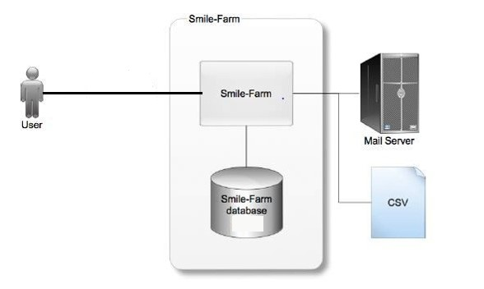
Context Diagram (Overall Project)
4
T002/ Version 1.0

Slide 5
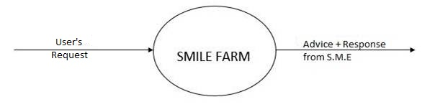
Data Flow Diagram (DFD)[Level-0]
5
T002/ Version 1.0

Slide 6
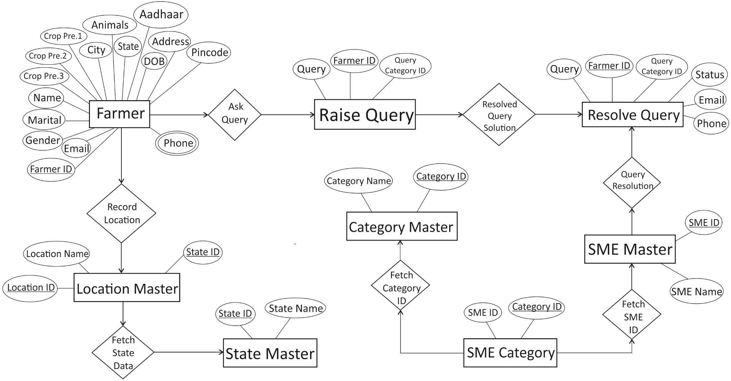
Entity-Relationship Diagram (ERD)
6
T002/ Version 1.0

Slide 7
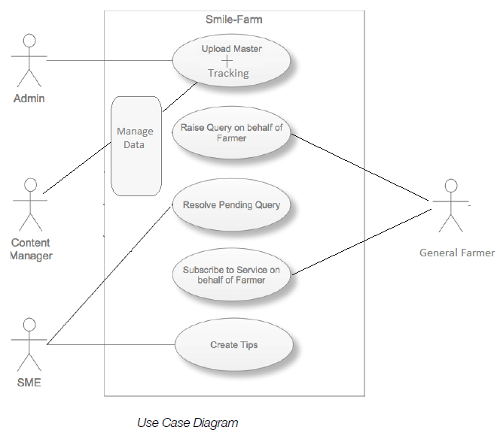
Use Case Diagram
7
T002/ Version 1.0

Slide 8
Advantage of The Project
The main advantages of ‘Smile-Farm’ are as follows:
Raising ‘Awareness’.
Availability and source of latest information in agriculture.
Source of “Valuable Tips” to improve productivity and well-being.
An interactive community for farmers to address their issues and problems.
Farmers can register themselves conveniently to get regular updates.
Provides SMS and E-Mail support to the users.
Providing portability of the whole community to be accessed from anywhere in the world.
8
T002/ Version 1.0

Slide 9
References, if any
Website References:-
https://trailhead.salesforce.com/en
https://www.quora.com/
https://help.salesforce.com/
https://www.youtube.com/
9
T002/ Version 1.0

Slide 10
THANKS

